Slide 1
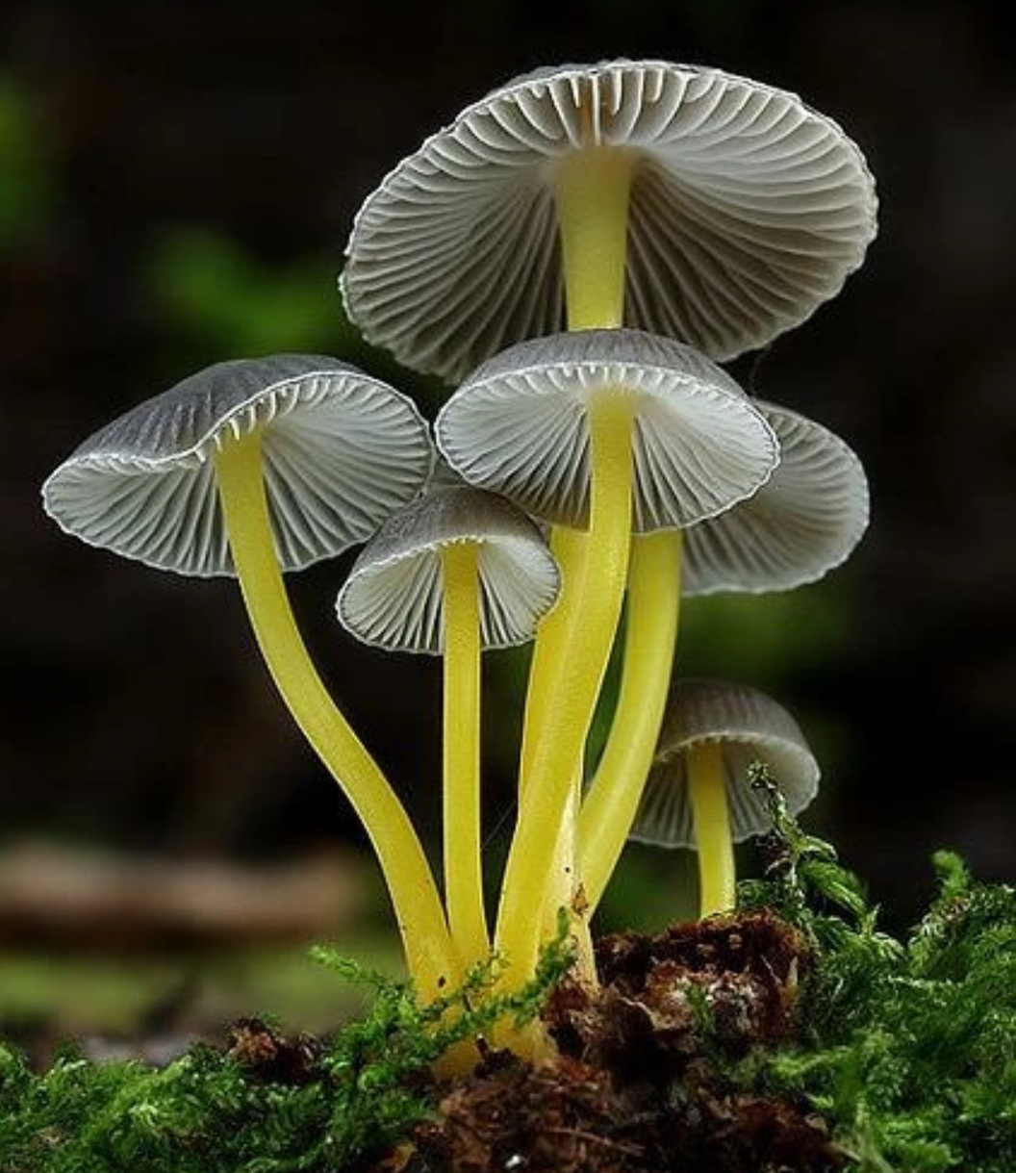


Data vs Wild Project # 2
Survival of Data Scientists

Slide 2
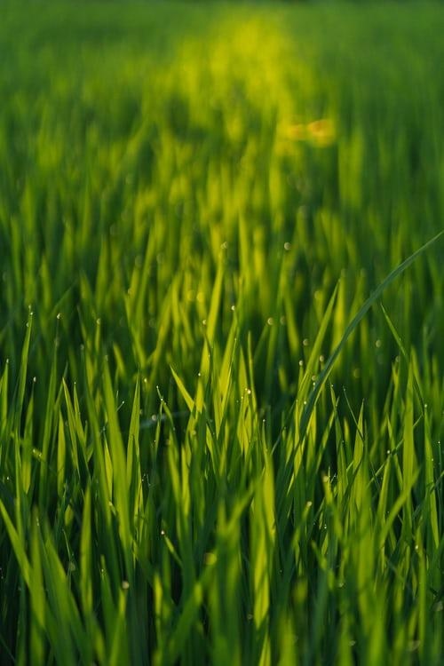
Project Team
Prabhat Sharma
Team Lead
Over 15 years of IT experience in the field of analytics focused in Financial Domain
Ilham Tirmizi
Data Scientist
Over 15 years of IT experience in ETRM
Rizwan Mohammed
Data Scientist
Over 10 years of IT experience in Data Integration and Business Architecture
Tariq Rahiman
Data Expert
Over 10 years of IT experience, QA Manager in Retail Domain
Hamza Khan
Domain Expert
Mechanical Engr Student
Advisors
Mo Medwani
Edward Bujak

Slide 3
Project Background
What do you do if you’re lost in the woods, you’re starving, and your only source of food is potentially poisonous mushrooms?
Panic. Run around in circles. (Outcome: run into an angry bear.)
Screw it. Grab the juiciest mushroom and dig in! (Outcome: nasty food poisoning.)
Psh. Who needs to eat? (Outcome: starve.)
None of the above.
Of course, we’re going with (D)! After all, we’re data scientists, right? And good data scientist should always carry 2 things: A laptop and a dataset of poisonous/non-poisonous mushrooms :-)
*Copy Paste from Problem Statement

Slide 4
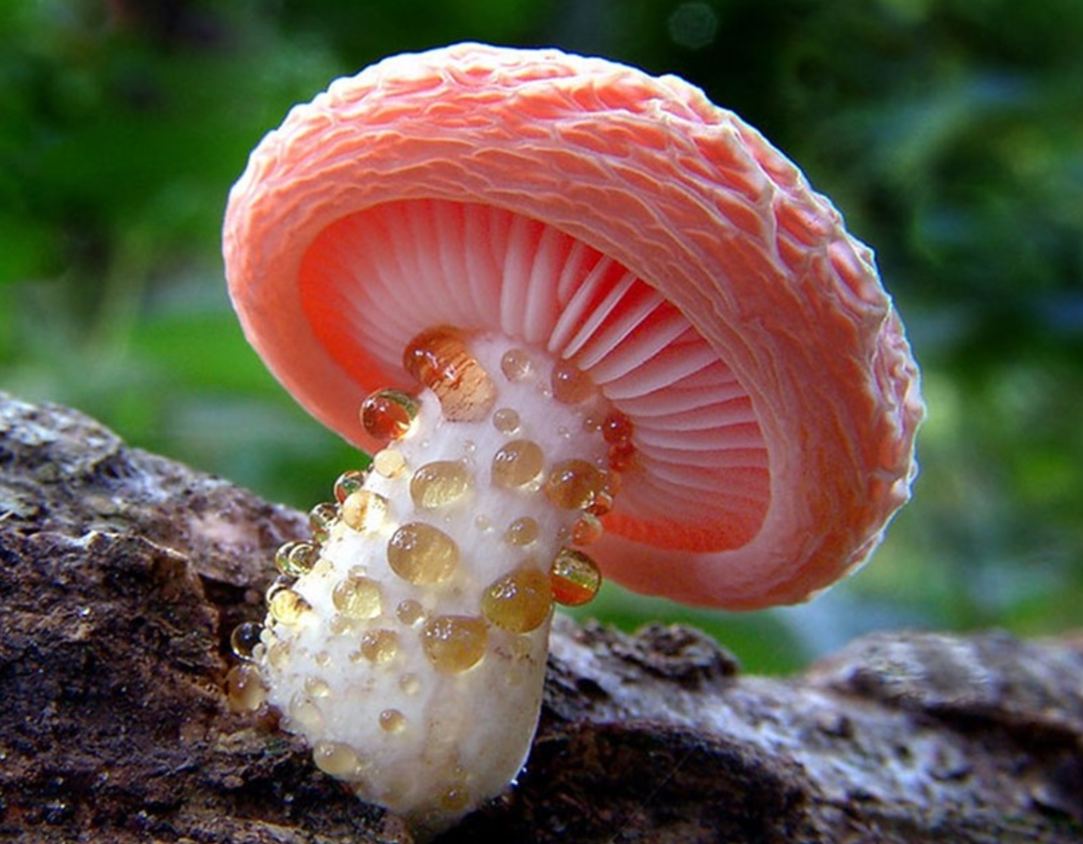
Project Objective
Objective is to predict whether a mushroom found in the wild is poisonous or not.

Slide 5
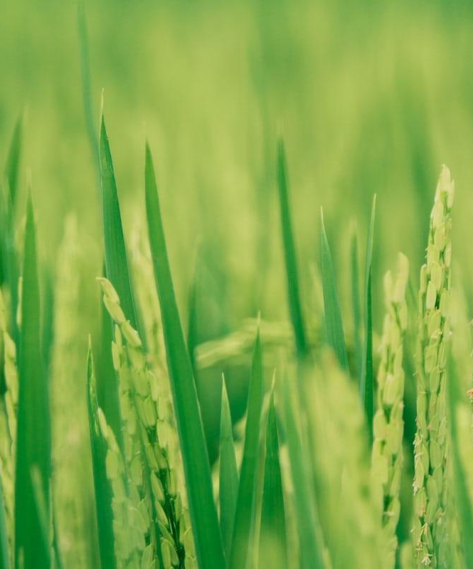
Descriptive Questions
Which are the top 3 important characteristics to identify a poisonous Mushroom?
What are common characteristics between non-poisonous and poisonous mushrooms?
What external factors (moss, soil, trees and animals nearby, etc.) impact the poisonous nature of a mushroom?

Slide 6
Predictive Questions
What is the likelihood that a mushroom is safe in the wild?
What is the likelihood that a brown stalk-color-above-ring mushroom is poisonous?

Slide 7
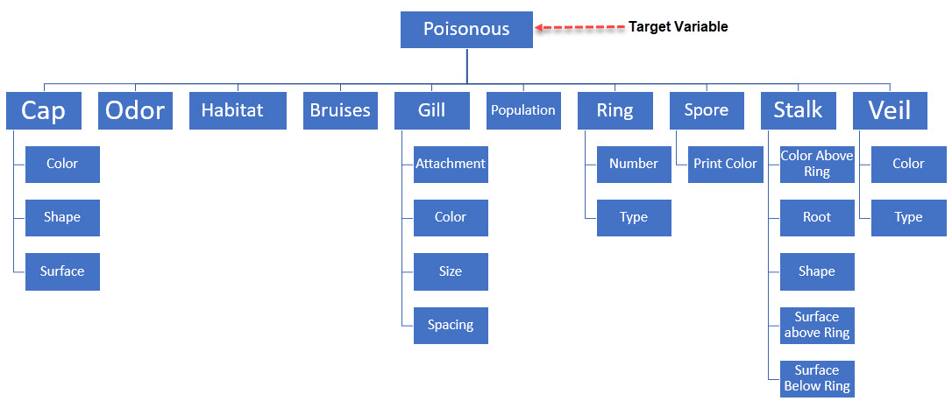
Analytics Base Table

Slide 8

Project Communication Channels
Trello
Project Management
Whatsapp
Messaging, Announcements
Slack
Organized Communications
Zoom
Video Conferencing Tool

Slide 9

Questions?

